Slide 1
We are debt advisers
Debt relief orders:
what do we know, what should we do?

Slide 2
Welcome to the session:
Amy Taylor,
Chair, Greater Manchester Money Advice Group

Slide 3
Agenda
A look back at the history and experience of DRO’s for our clients, and for us as debt advisers.
Brief comfort break.
A look ahead, at the current consultation and how we should respond.

Slide 4
Please sign the attendance list
We have put the link in the chat now.

Slide 5
DROs: a look back - some history (1/6)
Dept of Constitutional Affairs (DCA, now MoJ) consultation ‘A Choice of Paths’ (2004):
No Income, No Assets (NINA) ‘can’t pay’
Enforcement Restriction Order (ERO) ‘could pay’
Administration Order (AO) limit ⬆

Slide 6
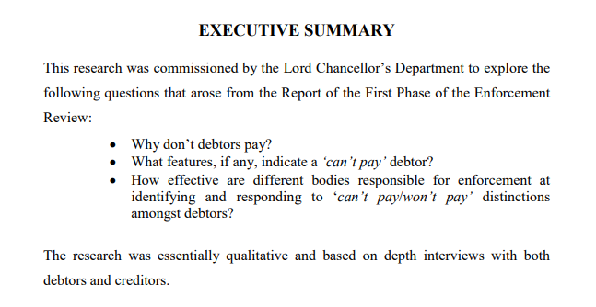
DROs: a look back - some history (2/6)
‘Can’t pay, or won’t pay’ PFRC, 2003

Slide 7
DROs: a look back - some history (3/6)
My consultation responses (can you remember yours?)
Law - 6th April 2009
‘Where are they now’ file (ERO, AO)
Further changes 2015

Slide 8
DROs: a look back - some numbers (4/6)
Almost 1700 AIs (approx)
£2.03 million in fees 2020 (£2.45 in 2019)
Refusals following submission less than 0.5%
Revocations 0.9%

Slide 9
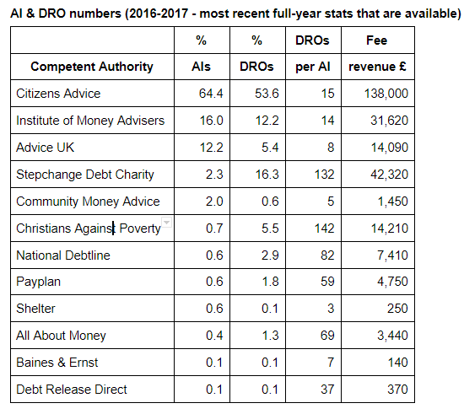
DROs: a look back - some numbers (5/6)

Slide 10
DROs: a look back - issues (6/6)
Fee (‘moderate’ DCA, 2004)
Excluded clients
Gatekeeping & diversions (not us)
The State & our relationship to/with it
‘DRO factories’ & alienation (adviser & client)
‘Sugar coating’ for BS ‘bitter pill’?

Slide 11
What are the biggest problems you have faced in helping clients to make DRO applications over the past year or so?
ⓘ Start presenting to display the poll results on this slide.
Notes:
📣 This is Slido interaction slide, please don't delete it. ✅ Click on 'Present with Slido' and the poll will launch automatically when you get to this slide.

Slide 12
Audience Q&A Session
(you can do this anonymously and also vote for the
questions and comments that others submit!)
ⓘ Start presenting to display the audience questions on this slide.
Notes:
📣 This is Slido interaction slide, please don't delete it. ✅ Click on 'Present with Slido' and the questions from your audience will appear when you get to this slide.

Slide 13
Please rank these factors in the order that they prevent people from accessing DROs
ⓘ Start presenting to display the poll results on this slide.
Notes:
📣 This is Slido interaction slide, please don't delete it. ✅ Click on 'Present with Slido' and the poll will launch automatically when you get to this slide.

Slide 14
Thinking about fees for DROs, how many of you agree with the following statements (tick all that apply):
ⓘ Start presenting to display the poll results on this slide.
Notes:
📣 This is Slido interaction slide, please don't delete it. ✅ Click on 'Present with Slido' and the poll will launch automatically when you get to this slide.

Slide 15
How should we best address the issue of funding for DRO applications? (choose one option only)
ⓘ Start presenting to display the poll results on this slide.
Notes:
📣 This is Slido interaction slide, please don't delete it. ✅ Click on 'Present with Slido' and the poll will launch automatically when you get to this slide.

Slide 16
Brief Comfort Break
Please sign the attendance list.
We have put the link in the chat.

Slide 17
The current consultation
Is restricted to the monetary eligibility criteria
Limit on total debt (increase to £30k)
Limit on ‘surplus income’ (increase to £100 pcm)
Limit on assets (increase to £2k) but…
No increase in vehicle asset limit

Slide 18
Timescales
Insolvency Service keen to limit changes to those that can be dealt with by regulations.
28 days process for these to be changed by Parliament
Would provide for changes to come in at same time as the ‘breathing space’ scheme on 4th May.

Slide 19
Issues to be considered (capacity)
Insolvency Service expects proposed changes to increase the number eligible for DROs to increase by 15,500 per year.
However, numbers needing debt advice expected to rise by 3 million through to end of 2021.
If DRO funding is inadequate now, then...

Slide 20
Issues to be considered (exclusion)
Why exclude people with debts over £30k?
Bankruptcy leads to identification of ‘hidden’ assets..?
Vehicle and asset limits
Deters applications from people at the margins of DROs?
Surplus income limit, based on Standard Financial Statement, will still exclude many people on below average incomes.

Slide 21
Issues to be considered (process)
Problems with revocation:
Backdated benefits and lump sums
Creditors (e.g. HMRC) belatedly finding debts
Official Receiver has ‘discretion’ to revoke - what could we ask for here?
Will IVA providers be required to reassess people who can now qualify for DROs?

Slide 22
Issues to be considered (poverty & work)
Essential expenditure based on actual spending of poorest 20%.
Even at £100 pcm over this, people in DROs are being asked to spend a year in poverty.
No incentive to increase income. Do we need a shorter discharge period/ greater flexibility?
Repeat need for DROs due to COVID?
Need for credit score rehabilitation - 6 years?

Slide 23
Do you agree (in principle) with increases to the debt limit, surplus income limit, and asset limits?
ⓘ Start presenting to display the poll results on this slide.
Notes:
📣 This is Slido interaction slide, please don't delete it. ✅ Click on 'Present with Slido' and the poll will launch automatically when you get to this slide.

Slide 24
What are the other changes would you like to see? (e.g. abolish debt limit, raise vehicle asset limits, abolish fees)
ⓘ Start presenting to display the poll results on this slide.
Notes:
📣 This is Slido interaction slide, please don't delete it. ✅ Click on 'Present with Slido' and the poll will launch automatically when you get to this slide.

Slide 25
Audience Q&A Session
ⓘ Start presenting to display the audience questions on this slide.
Notes:
📣 This is Slido interaction slide, please don't delete it. ✅ Click on 'Present with Slido' and the questions from your audience will appear when you get to this slide.

Slide 26
Do you agree that we should be
campaigning for the following:
ⓘ Start presenting to display the poll results on this slide.
Notes:
📣 This is Slido interaction slide, please don't delete it. ✅ Click on 'Present with Slido' and the poll will launch automatically when you get to this slide.

Slide 27
Is there anything else you would like to say?
ⓘ Start presenting to display the poll results on this slide.
Notes:
📣 This is Slido interaction slide, please don't delete it. ✅ Click on 'Present with Slido' and the poll will launch automatically when you get to this slide.

Slide 28
Next Steps
We will write up a consultation response and publish this on our website by 15th February.
We will e-mail you when this is done.
We will provide an opportunity for people to add their signatures to the response on the website.
Please tweet, circulate, and ask others to sign too.
We will send it in by the deadline of 26th February.

Slide 29
Thanks for participating!
We will e-mail those who have signed the register with confirmation of their attendance so you can claim your CPD points.
And mail out a short survey seeking feedback on the session.
Stay in touch at https://wearedebtadvisers.uk

